Slide 1
Certificate Program in Environmental Health Sciences
Nicole M. Robles–Matos
PGG PhD Candidate
Bartolomei Lab

Slide 2
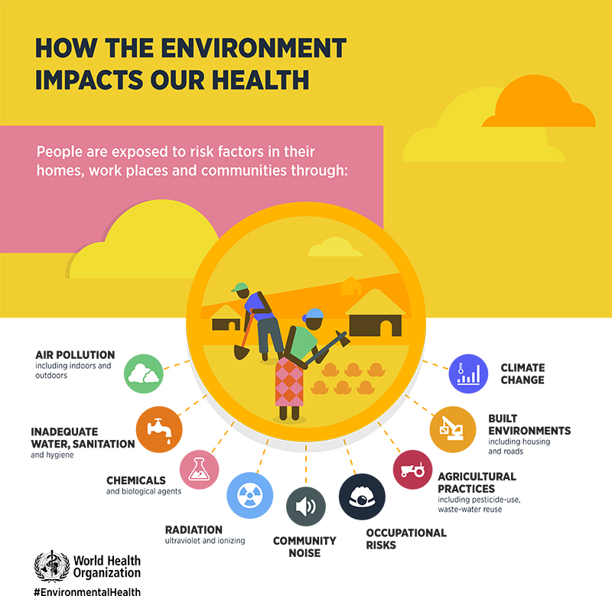
Undergraduate Education & Interest in Environmental Health
Undergraduate Studies
  University of Puerto Rico, Rio Piedras Campus (UPR-RP)
  Chemistry - Major
Undergraduate Research
  UPR-RP: Organic Chemistry – synthesis of natural products
  Rutgers University: targeted therapeutics/ drug delivery
  UPenn: iron deficiency and epigenetics
Graduate Studies
  Pharmacology
  Certificate Program in Environmental Health Sciences
Notes:
[Describe (i) Undergraduate Background and (ii) why you had an interest in environmental
Health sciences]

Slide 3
Course Work in Pharmacology & Certificate Program in EHS
Pharmacology Course Work
  Fundamentals of Pharmacology
  Cell Biology and Biochemistry
  Biological Data Analysis
  Topics in Molecular Medicine
  PGG Journal Club
  Medical Pharmacology
  Human Physiology
  Molecular Toxicology
  Regulation of the Genome
Certificate Program in EHS Course Work
  Cell Biology and Biochemistry
  Biological Data Analysis
  Molecular Toxicology
  Regulation of the Genome***
  Introduction to Epidemiological Research Methods
  Statistical Methods and Data Analysis
  Environmental and Occupational Health
  Community-based rotation
***A substitute for Experimental Genome of the Science course requirement***
Notes:
[List the courses you took up to candidacy exam for PhD thesis work]
[List the courses you took in Certificate Program in EHS]
[Describe Community Based Environmental Health Rotation –could be a separate slide]
Describe any mentorship of TREES or STEER program ]

Slide 4
Community-based Rotation
Environmental Justice: Lead Exposure in the Latinx/Hispanic Community of South Philadelphia
Objectives
  Investigate the current knowledge and beliefs about lead poisoning among Latino/Hispanic communities established in South Philadelphia (primarily Mexican origin)
  Identify and develop culturally appropriate education strategies to include Latino/Hispanic communities in lead prevention programs
Strategies
  Collaboration with Puentes de Salud
  Culturally appropriate messages about lead poisoning prevention through radio interview (Philatinos) and short video
Notes:
Environmental Justice: Lead Exposure in the Latinx/Hispanic Community of South Philadelphia

Slide 5
T32 Training Grant in Environmental Health Sciences
T32 in Environmental Health Sciences
  Supported my thesis research for 3 years
  T32 Research in Progress Talks
  CEET Seminar Series
  CEET Annual Symposium
  Financial support to attend and present at National Conferences (Society of Toxicology)
Notes:
[ Supported by T32 for Three Years:
List Training Grant Activities that you participated in
-T32 Research Training Talks
-CEET Seminar Series
-CEET Annual Symposium
Attend and present at National Mtgs e.g. SOT]

Slide 6
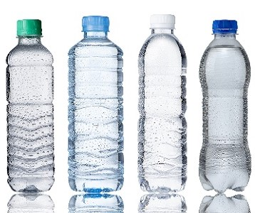
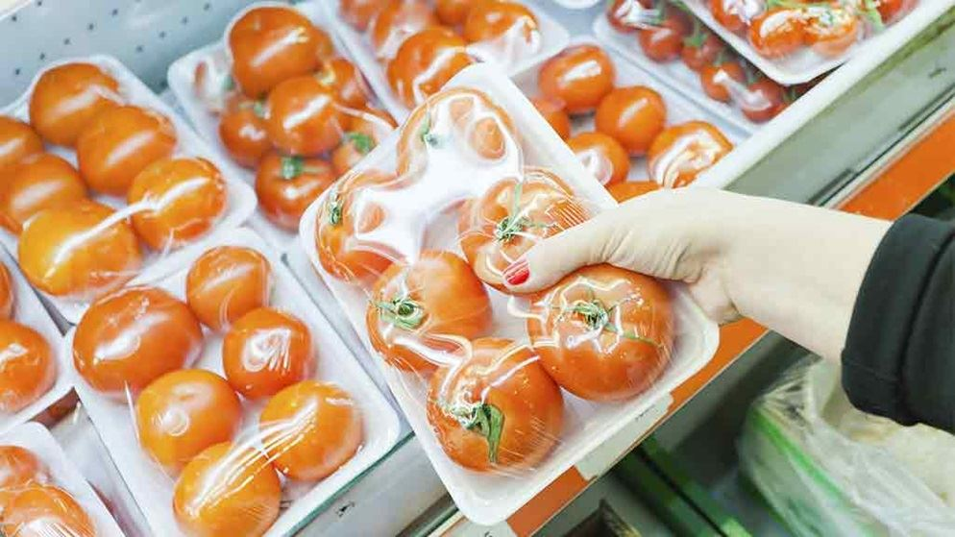


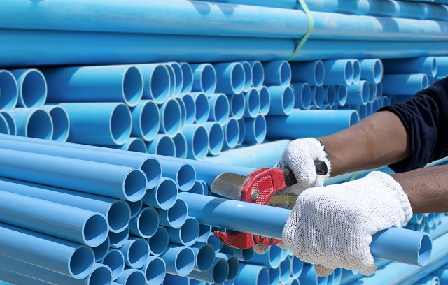
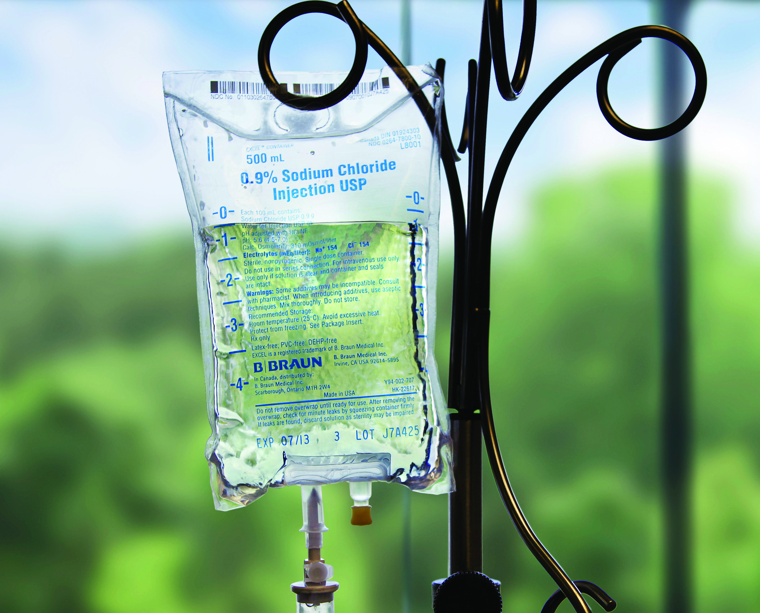
Thesis Research Topic – Bartolomei Lab
  Investigating the influence of periconceptional exposure to DEHP on DNA methylation and disease risk by dissecting windows of DEHP susceptibility and sex-specific effects
DEHP
Use and
Exposure
Di-(2ethylhexyl)-phthalate (DEHP)
Synthetic industrial chemical
Ubiquitous in our environment
Endocrine Disrupting Chemical
Anti-androgen effects
Notes:
[Describe Thesis Research Topic-include Figures]

Slide 7
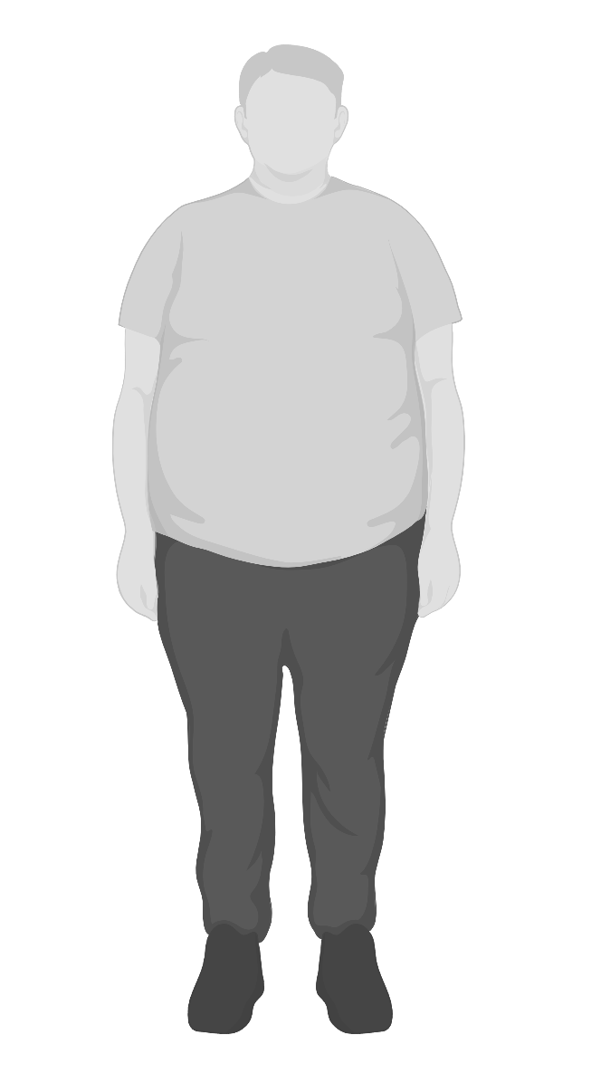
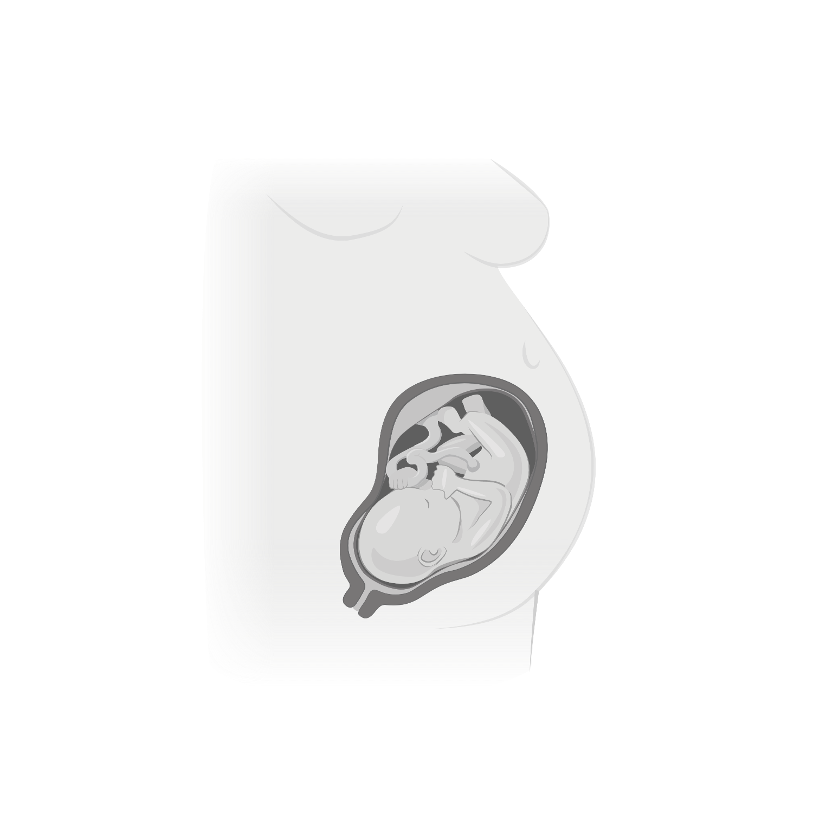
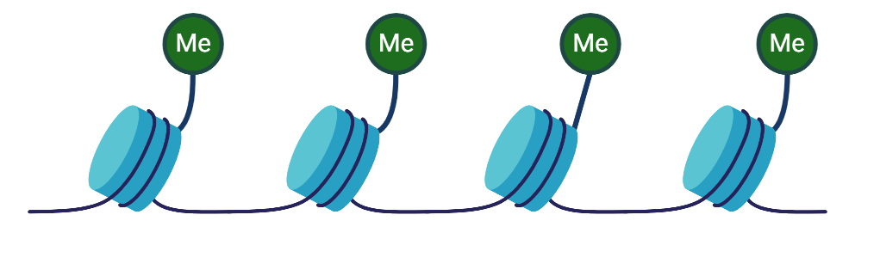
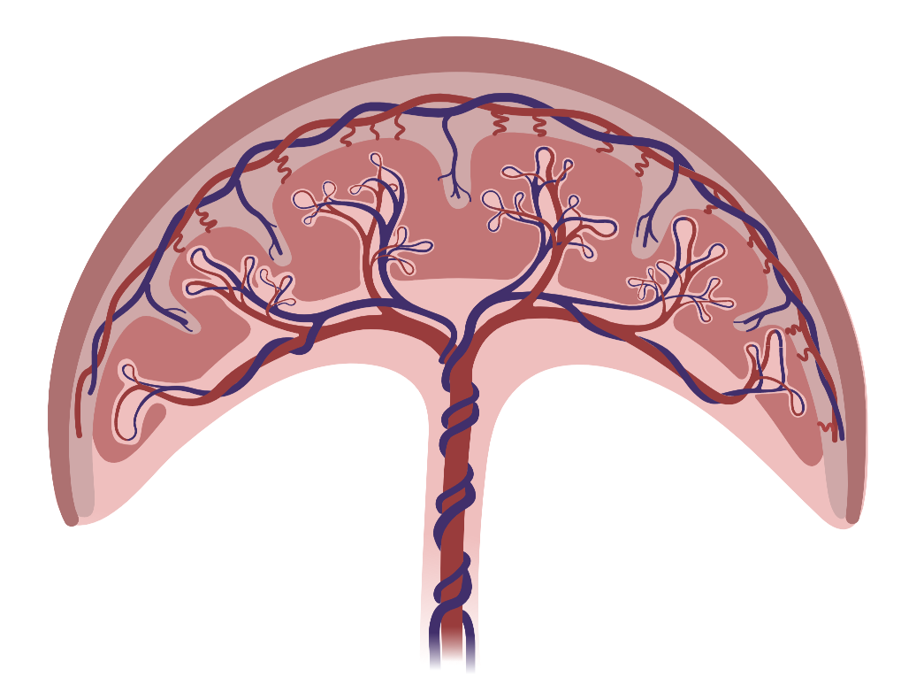
Theses Research Topic – Bartolomei Lab
EDCs
Barker, D. (2004) Journal of Epidemiology and Community Health
F1
Obesity
NAFLD
Diabetes
Metabolic Syndrome
Immune Dysfunction
Neurological
Cardiovascular
???
Developmental Origins of Health and Disease (DOHaD)
F0
Epigenetic Dysregulation
DNA Methylation
F1
Adverse early life event
Environmental insults
Increase risk of adult diseases
Placenta

Slide 8
Thesis Research Topic - Bartolomei Lab
Pregnant F0
♀
Control
Lower DEHP
Upper DEHP
2 weeks prior
conception
GD 0.5
Window 3
F1
Adult
Window 2
Oocyte maturation
Embryo de- and re-methylation
Window 1
Preconception
Mating
Gestation
14 days
7 days
19-21 days
E12.5
E18.5
Control = low phytoestrogen, 7% corn oil
Lower = 50 ug/kg*bw/day
Upper = 10 mg/kg*bw/day
Rf Dose = 20 ug/kg bw/day
Liver Metabolomics
Liver Histology
Growth and Metabolism
F1
♀ ♂
Epigenetics, Placenta Morphology
Notes:
Include animations

Slide 9
Career Trajectory
Papers Published or Planned
  Bansal, A., Robles-Matos, N., Wang, P.Z., Condon, D.E. Joshi A., and Pinney, S.E. In utero bisphenol A exposure is linked with sex specific changes in the transcriptome. J. Clinical Endocrinol. & Metabolism 2019
  Robles-Matos, N., et al. Environmental Exposure to Endocrine Disrupting Chemicals Influences
  Genomic Imprinting, Growth, and Metabolism. Genes 2021
Target Thesis Defense Date: December 2022
What will I do when I graduate?
  Government Agencies (Public Health Departments, EPA, etc.) working on Environmental Justice
  Science Communication
How has my training prepared me for my career goals?
  Networking through CEET events and alumni
  Public Health Training
  Community outreach (CEET, SACNAS, LAGAPSA, SEA Philly, PARS)

